Slide 1
Cardiovascular Risk Prediction Analysis
by Debanjan Ganguly
Data Science Trainee
AlmaBetter, Bengaluru

Slide 2


Introduction
Heart diseases are the most common cause of death worldwide over the last few decades in the developed as well as underdeveloped and developing countries. Early detection of cardiac diseases and continuous supervision of clinicians can reduce the mortality rate. However, accurate detection of heart diseases in all cases and consultation of a patient for 24 hours by a doctor is not available, since it requires more sapience, time and expertise.
Good data-driven systems for predicting heart diseases can improve the entire research and prevention process, making sure that more people can live healthy lives. This is where Machine Learning comes into play. Machine Learning helps in predicting the Heart diseases, and the predictions made are quite accurate.
This risk prediction analysis focuses on the supervised ML-based approach, which is computationally fast and exhibits promising classification results. We’ll walk through a tuned baseline model for detecting heart disease from patient data and make some predictions.

Slide 3

Problem Statement & Approach
We’re required to build a classifier to predict the risk related to Coronary Heart Disease or Heart Attack. The dataset is from an ongoing cardiovascular study on residents of the town of Framingham, Massachusetts. The classification goal is to predict whether the patient has a 10-year risk of future coronary heart disease (CHD).
Dataset contains over 3000 records and 15 attributes. Each attribute is a potential risk factor. There are both demographic, behavioral, and medical risk factors. Sex & Age are demographic attributes, is_smoking & Cigs Per Day are behavioral attributes. Rest of the are attributes are medical history or patients’ data contains both nominal and continuous data.
Data Preparation
Feature Selection
Defining Pipeline
Model Training
Risk Prediction
EDA

Slide 4
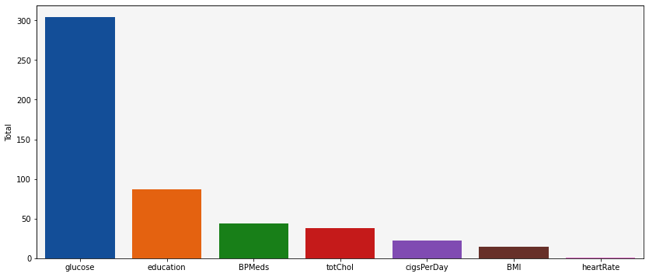
Exploratory Data Analysis
1
Distribution of N/A Values
Total percentage of missing data is 15.04%, of which the highest is for glucose that accounts for 9% of missing data. Next to it is education which accounts for only ~3 of total data. So, we will drop all null values. Also, we will drop id column since it is an auto increment column only.

Slide 5
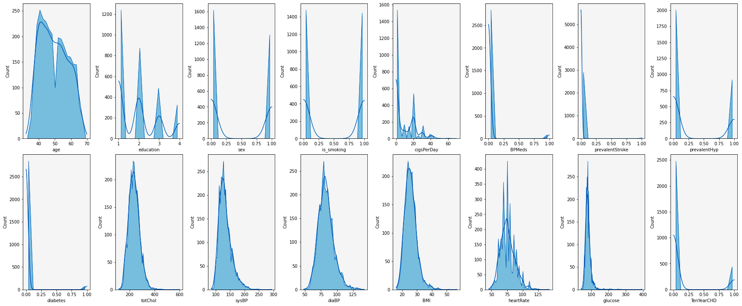
Exploratory Data Analysis
2
Data Distribution

Slide 6
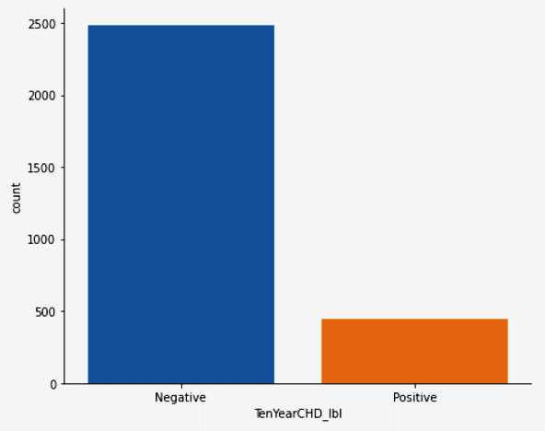
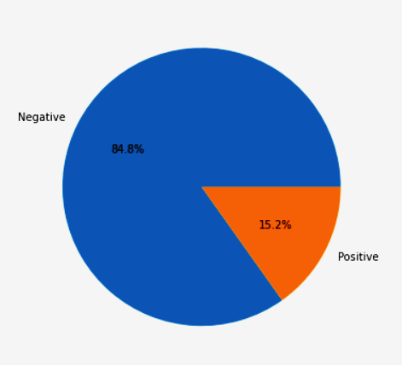
Exploratory Data Analysis
3
Proportion of Target Labels

Slide 7
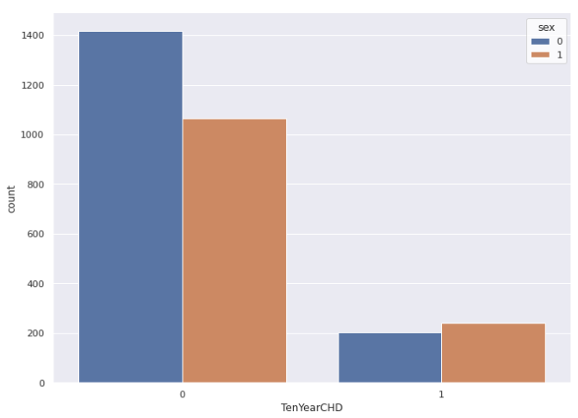
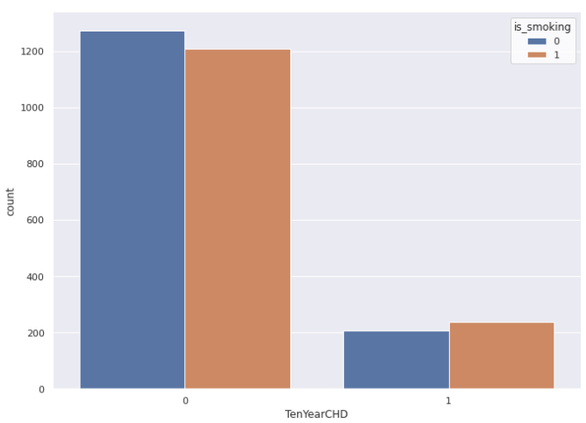
Exploratory Data Analysis
4
Chances of CHD over sex & habit of smoking

Slide 8
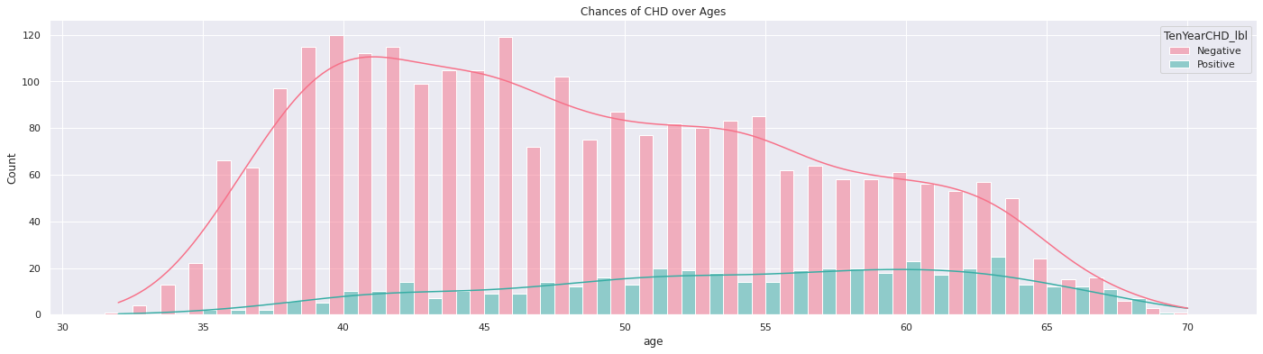
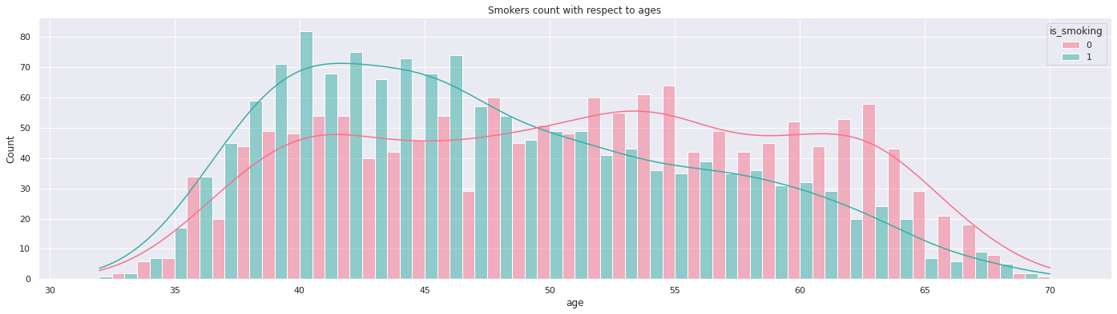
Exploratory Data Analysis
Chances of CHD over Ages
5
6
Smokers count over Ages

Slide 9
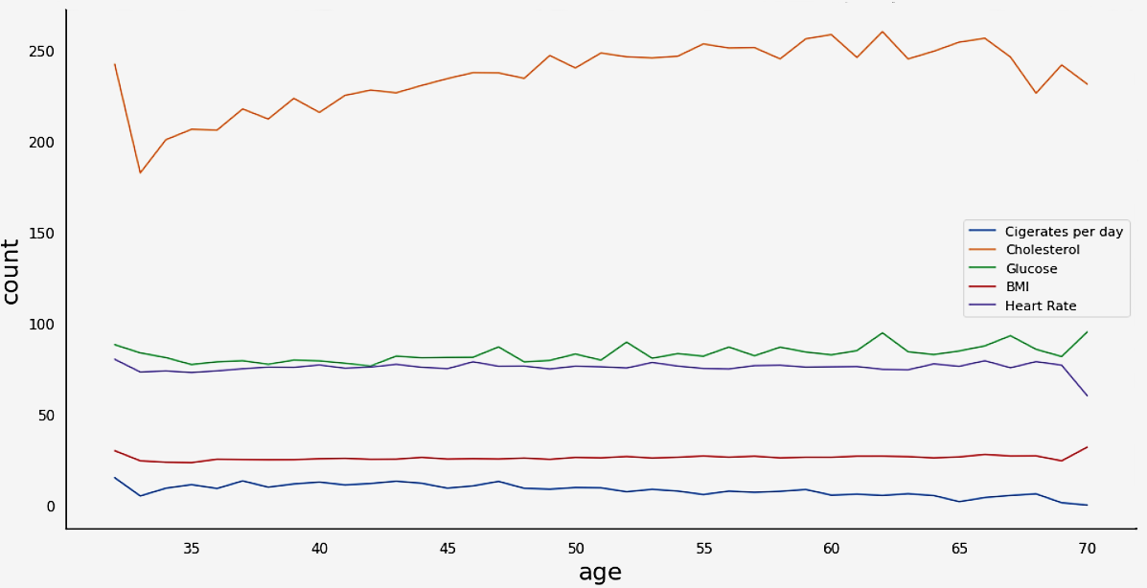
Exploratory Data Analysis
7
Distribution of Medical Features in every Age group

Slide 10
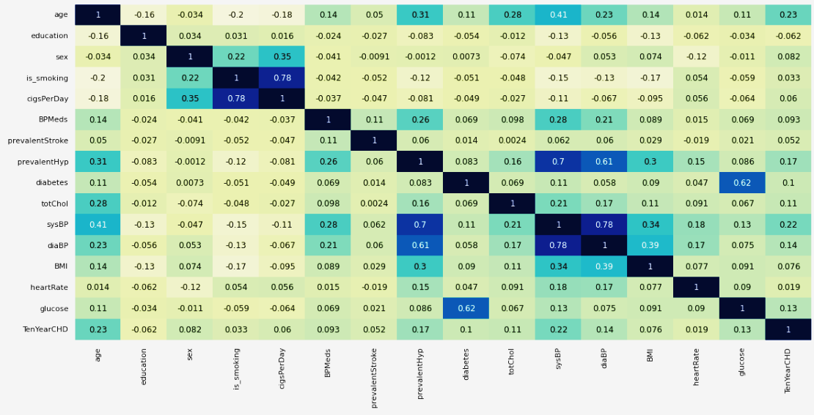
Exploratory Data Analysis
8
Heatmap of Features Correlation

Slide 11
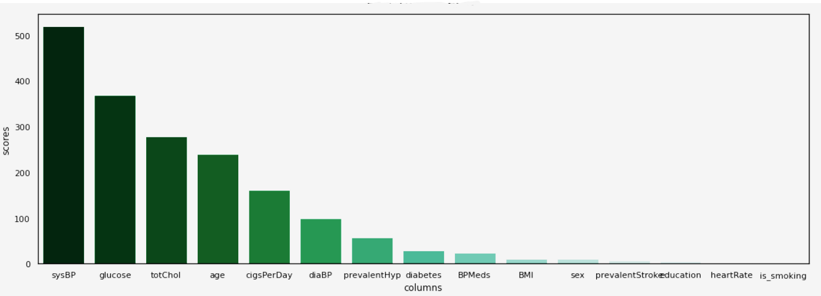

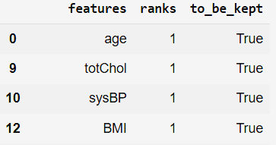


Feature Selection
Selected Features
age
diaBP
sysBP

Slide 12
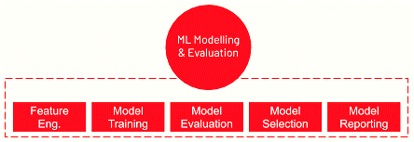
ML Modelling & Evaluation
Once the features were selected, it is then passed through pipeline. A pipeline is a linear sequence of data preparation options, modeling operations, and prediction transform operations. It allows the sequence of steps to be specified and evaluated
Pipeline is beneficial to prevent data leakage, and to add reproducibility.
2 different Pipelines are created :
1
Steps involved are Normalization (StandardScaler) > Cross Validation (ShuffleSplit, Halving grid search)
No resampling has been done. Training done on 6 different models, with hyper parameter tuned during 10-fold cross validation
2
Steps involved are Normalization (StandardScaler) > Over Sampling (SMOTE) > Cross Validation (ShuffleSplit, Halving grid search)
Pipeline first applies SMOTE to our dataset, then applies Random Undersampling to the output of the SMOTE transform before returning the final outcome. It allows transforms to be stacked or applied in sequence on a dataset. The same 6 ml algorithms has been used to train model within pipeline.

Slide 13
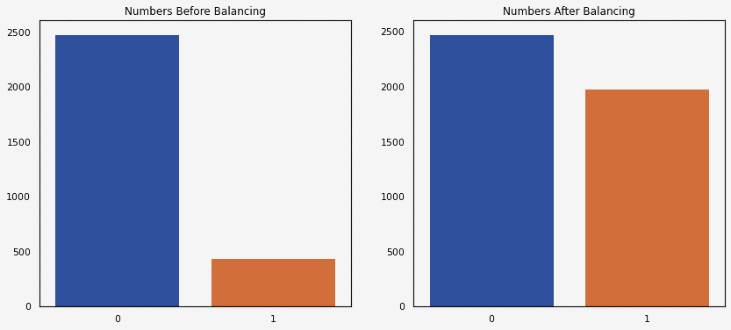
ML Modelling & Evaluation
Once the features were selected, it is then passed through pipeline. A pipeline is a linear sequence of data preparation options, modeling operations, and prediction transform operations. It allows the sequence of steps to be specified and evaluated
Pipeline is beneficial to prevent data leakage, and to add reproducibility.
2 different Pipelines are created :
1
Steps involved are Normalization (StandardScaler) > Cross Validation (ShuffleSplit, Halving grid search)
No resampling has been done. Training done on 6 different models, with hyper parameter tuned during 10-fold cross validation
2
Steps involved are Normalization (StandardScaler) > Over Sampling (SMOTE) > Cross Validation (ShuffleSplit, Halving grid search)
Pipeline first applies SMOTE to our dataset, then applies Random Undersampling to the output of the SMOTE transform before returning the final outcome. It allows transforms to be stacked or applied in sequence on a dataset. The same 6 ml algorithms has been used to train model within pipeline.

Slide 14
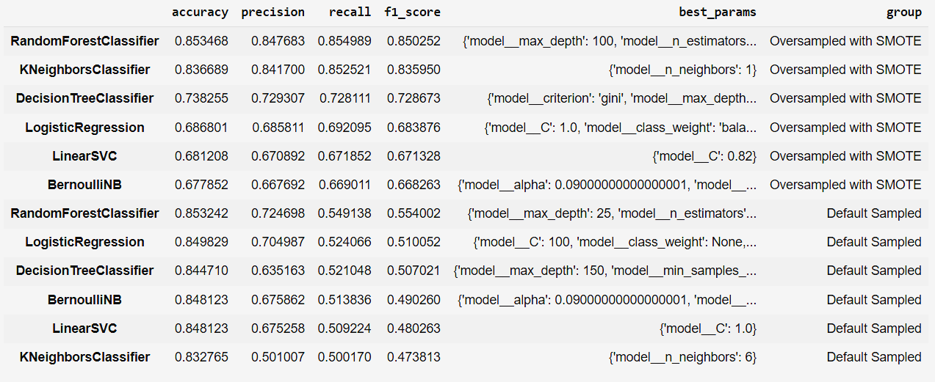
Model Selection
Ranks of Pipelines by F1 Score
Best performance achieved with RandomForestClassifier model with an f1 score of 0.85 and recall of 0.855. Clearly, model trained on dataset oversampled with SMOTE ranks top in every metrics.
The performance of K-Nearest Neighbors increased most with over sampled dataset.

Slide 15
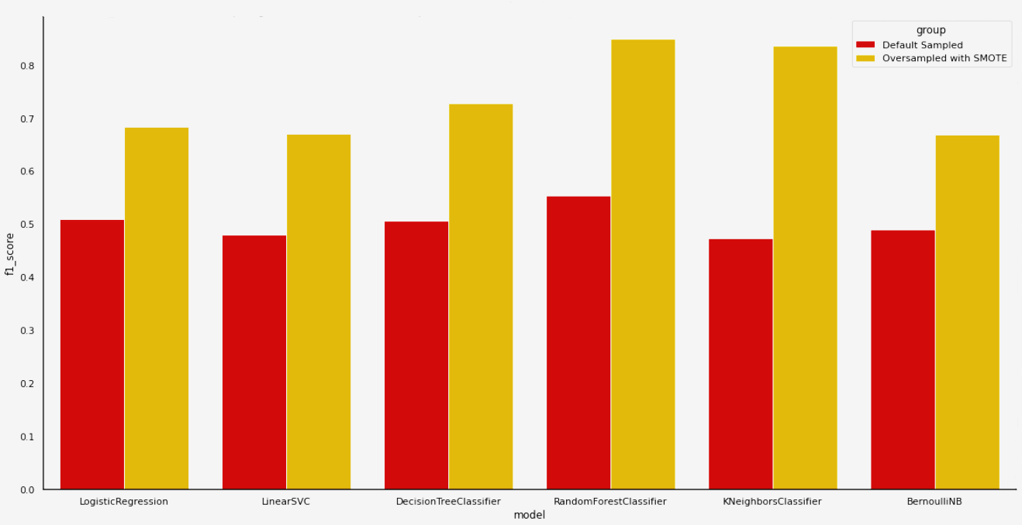
Model Selection
Comparison of F1 score
Best performance achieved with RandomForestClassifier model with an f1 score of 0.85 and recall of 0.855. Clearly, model trained on dataset oversampled with SMOTE ranks top in every metrics.
The performance of K-Nearest Neighbors increased most with over sampled dataset.

Slide 16
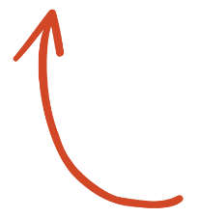

Model Evaluation
Final model has been built on RandomForestClassifier
1
Evaluating Model Parameters & Performance Score
Sampling Ratio Maintained: 0.8
Random Forest: max_depth = 100 ; n_estimators = 500 b

Slide 17
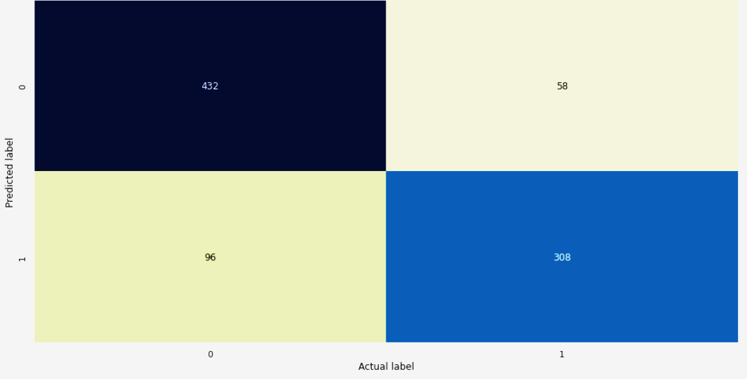
Model Evaluation
Final model has been built on RandomForestClassifier
1
Evaluating Model Parameters & Performance Score
2
Plot Confusion Matrix

Slide 18
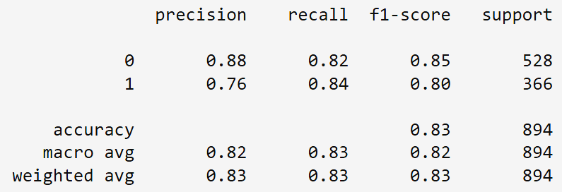
Model Evaluation
Final model has been built on RandomForestClassifier
1
Evaluating Model Parameters & Performance Score
2
Plot Confusion Matrix
3
Preview of Classification Report
Balanced Accuracy Score : 0.8298
Avg. Weighted F1 Score : 0.8287

Slide 19
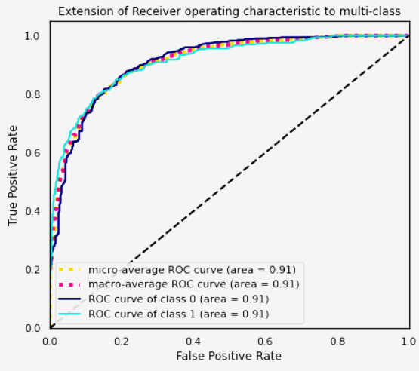
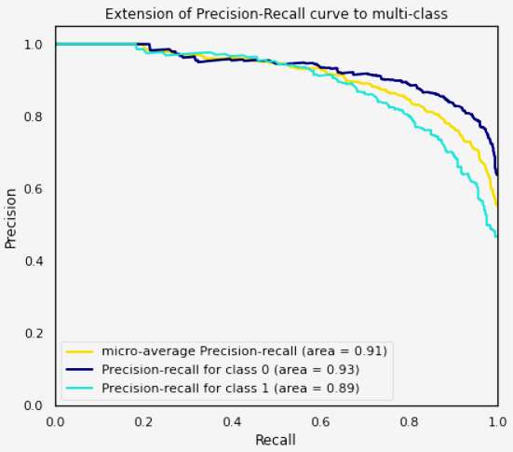
Model Evaluation
Final model has been built on RandomForestClassifier
1
Evaluating Model Parameters & Performance Score
2
Plot Confusion Matrix
3
Preview of Classification Report
4
Plot Extension of ROC Graph & Precision-Recall curve to multi-class

Slide 20
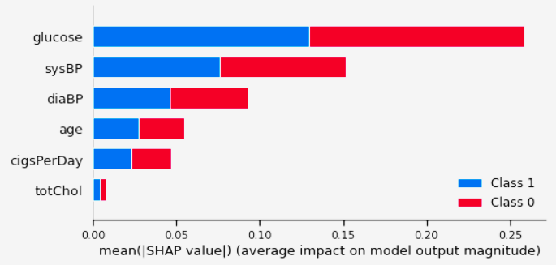
Model Evaluation
Final model has been built on RandomForestClassifier
1
Evaluating Model Parameters & Performance Score
2
Plot Confusion Matrix
3
Preview of Classification Report
4
Plot Extension of ROC Graph & Precision-Recall curve to multi-class
5
Feature Importance using SHAP

Slide 21

Limitations
1
As a binomial classification problem with imbalanced dataset, we can assume dataset has some bias added within it
2
Most of the data on the positive cases were artificially synthesized using SMOTE and as such they may not be a true representation of the actual population
3
The interpretation of this result is limited to the risk of myocardial infarction or coronary death for the next 10 years only.

Slide 22

Future Scope & Improvements
1
We could try to add more data to our set to generalize, especially the data from actual positive cases as most of the data we’re working is artificially synthesized data
2
We’ve achieved a recall of 0.82, but in a sensitive field like CHD, we can’t afford to have a single false positives. So, we need to work on improving recall.
3
Some other standardization techniques like MinMaxScaler can also be tried. Dimensionality reduction technique like PCA can also be used for improved result.
4
Ensemble ml algorithms like XGBoost, BaggingClassifier, ExtraTreesClassifier can also be tried for better results. We can also move on to try deep learning methods.

Slide 23

Conclusion
1
The most important features in prediction are glucose and sysBp
2
Random forest is the best performed learning algorithm. The recall is ~83% which is somewhat satisfactory but not in sensitive cases like these. It simply means, out of 100 every 13 peoples with the risk of CHD leave untreated without knowing anything.
3
The area under roc curve is 0.91 which is satisfactory.
4
Balancing the dataset using SMOTE helped tremendously in improving the model performance. But overall model could be improved with more records of actual positive classes
5
Males seem to be more susceptible to heart disease than females. Increase in Age, number of cigarettes smoked per day and systolic Blood Pressure also show increasing odds of having heart disease

Slide 24


Thank You
Link to GitHub Project Repo
Link to Drive Project Folder
Link to Colab Notebook
As part of Supervised ML Classification Project by

